Slide 1
Ecommerce Customer

Slide 2
Agenda
Problem Statement
Business Objective
Data Preprocessing
EDA
Model Building
Model Evaluation
Problems and Solutions

Slide 3
Problem Statement
Determine whether the company should prioritize improving the mobile app experience or the website to maximize customer engagement and sales.

Slide 4
Business Objective
Interpret which variables are contributing towards the more annual
income prediction and build a prediction model

Slide 5
Data Preprocessing
There are
8 rows
X features : 4 rows
Y feature : 1 row
Removed unimportant columns : Email, Address, Avatar.
No Duplicates
There were many outliers so eliminated them.
Standardization is also done

Slide 6
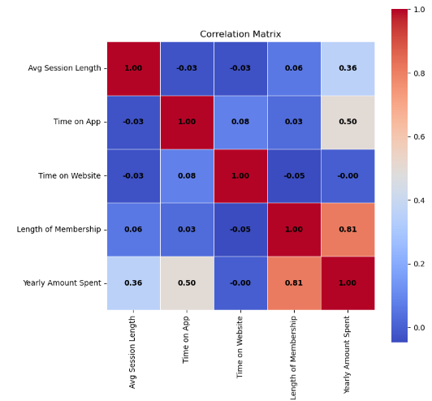
EDA
Length of Membership is the most influential feature for predicting Yearly Amount Spent and should be prioritized in modeling.
Time on App also contributes significantly, while Time on Website appears irrelevant for predicting annual spending.

Slide 7
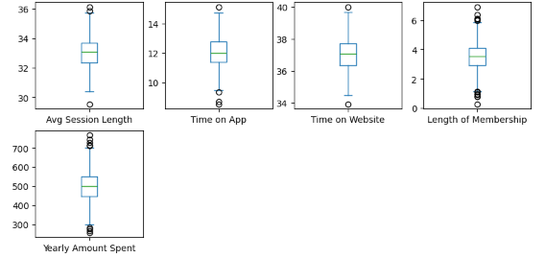
EDA
Presence of Outliers: Most features exhibit some degree of outliers. These may need further investigation to decide if they are valid or should be addressed (e.g., removed or transformed).

Slide 8
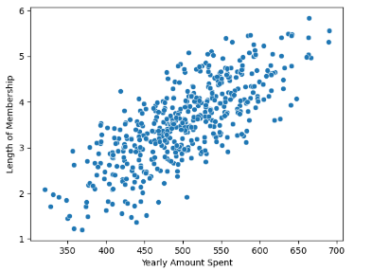
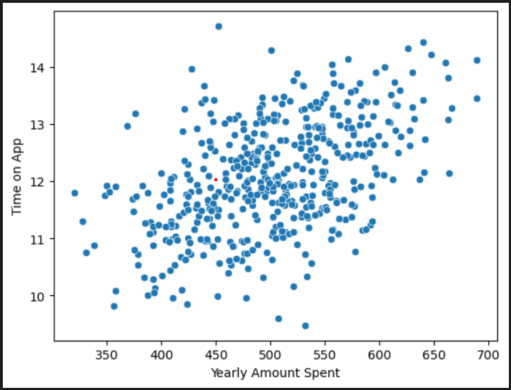
EDA
Length of Membership and Time on app has positive relation with Yearly Amount Spent.

Slide 9
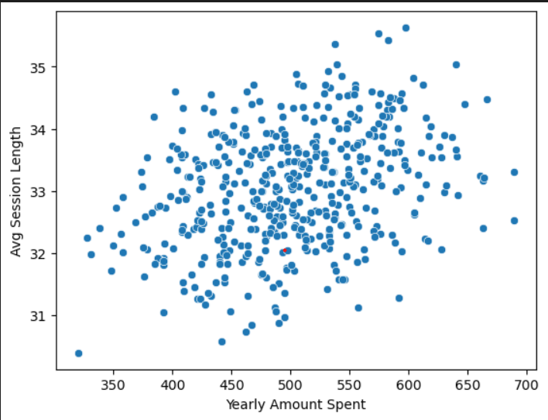
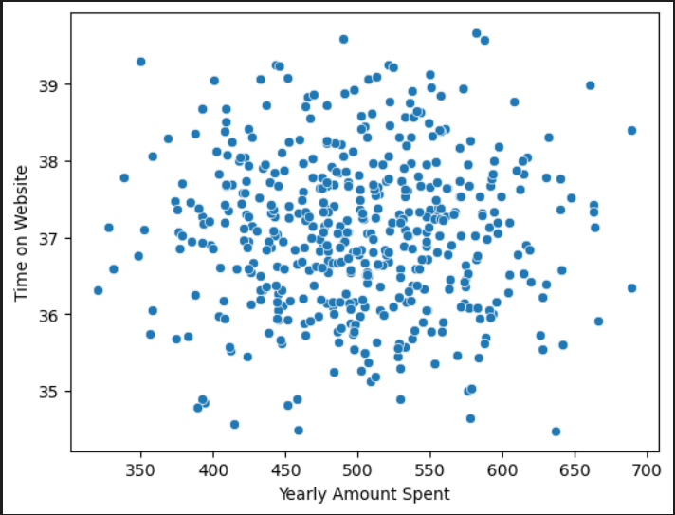
EDA
Avg Session Length and Time on Website has low positive relation and no relation with Yearly Amount Spent respectively.

Slide 10
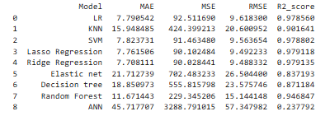
Model Selection
Considering MSE and R2_score selecting Linear Regression is best option.

Slide 11
Conclusion
Our conclusion is Linear Regression Model.
There is a linear relationship between the features and the target variable.
There is little to no multicollinearity between the features.
Data Set has a relatively small number of features compared to the number of observations.

Slide 12
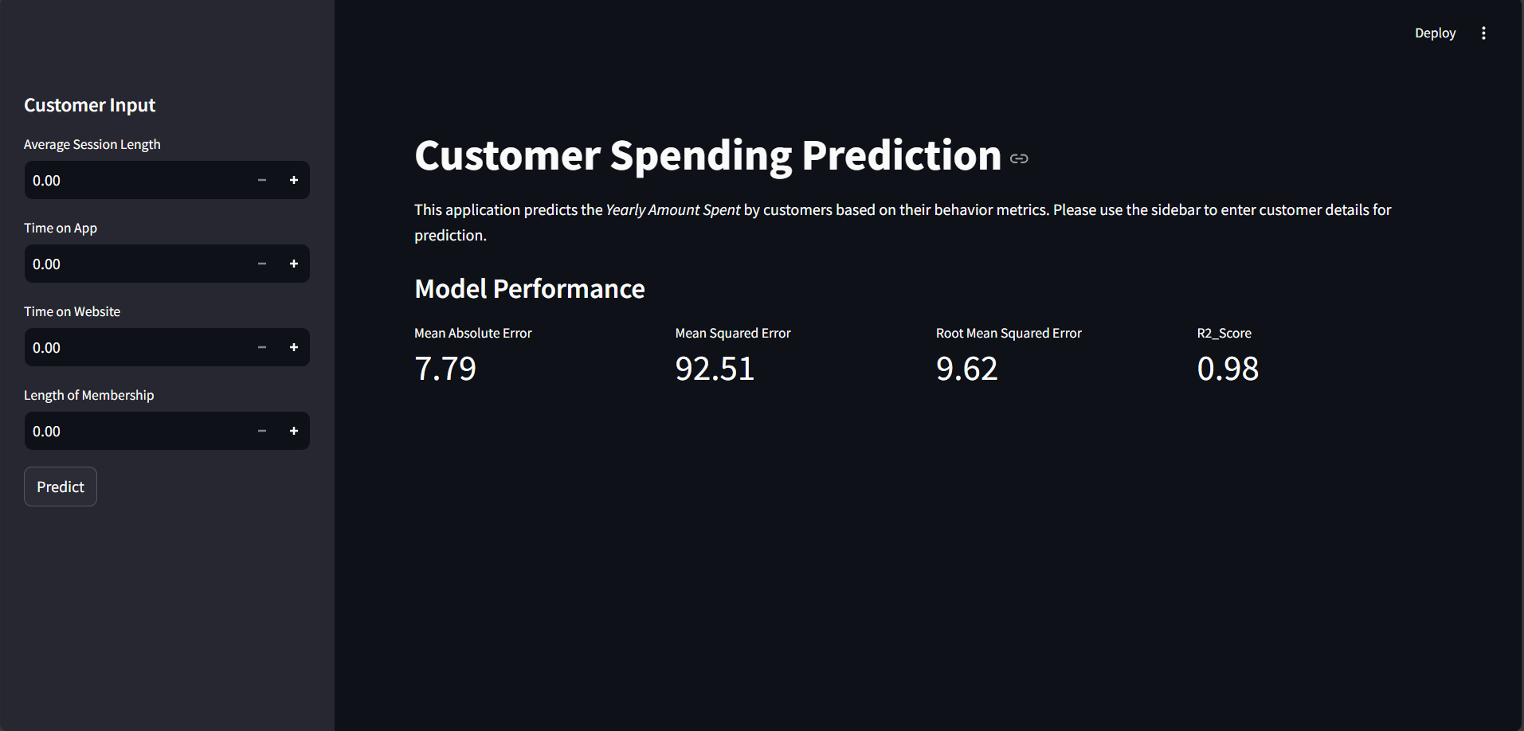
Deployment

Slide 13
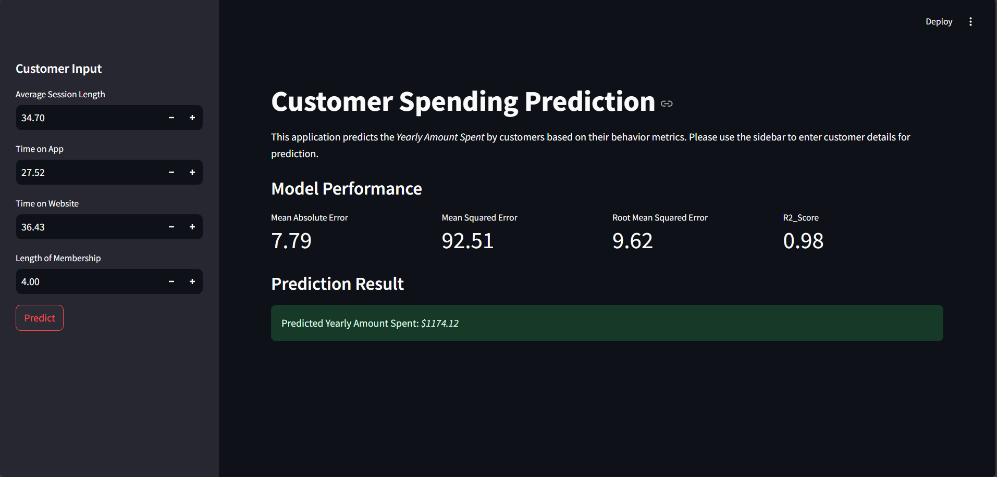
Deployment

Slide 14
Challenges Faced and Potential Solutions
Because of some columns calculation of correlation and other things became hard.
Removed unimportant columns such as Email, Address, Avatar.
Many Models gave the similar output so selecting the model was a bit difficult.
Considered the data and its properties.
Compared many models and based on the importance of model on dataset linear regression works well.

Slide 15

Team Members
Tanguturi Sai Pravallika
Bhargavi Rageeru
Shital Manik Chavan
Bharad Archana Vilas
Veena Kandalam
Samiksha S. Janjirkar
Nagella Naga Prasanna

Slide 16
Thank You

